Slide 1
Chongqing University of Technology
ATAI
Advanced Technique of Artificial Intelligence
Chongqing University of Technology
Multi-Modal Sarcasm Detection via Graph Convolutional Network and Dynamic Network
Code：None
2025.2.13 • ChongQing
—— CIKM 2024
Reported by Peng Shan

Slide 2
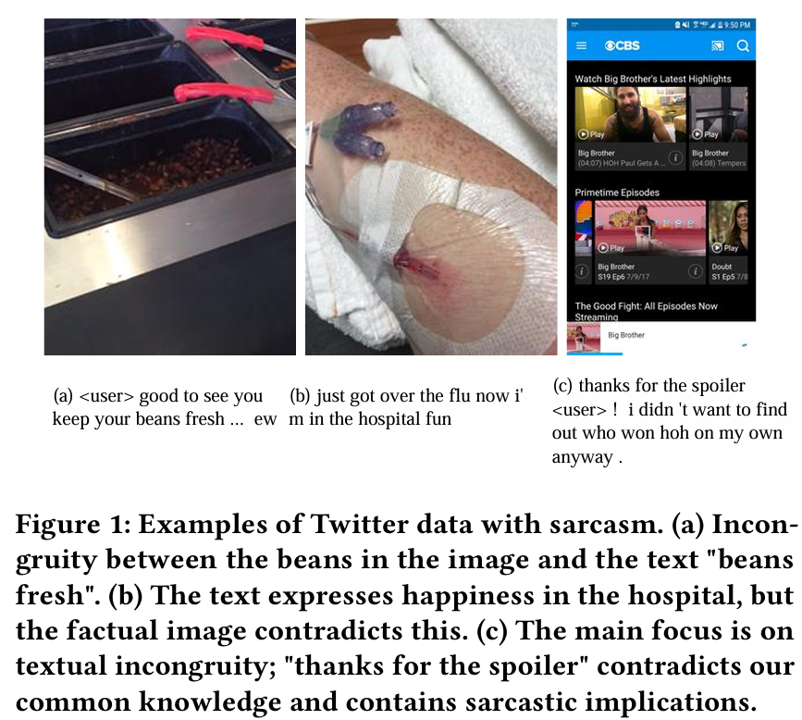
Motivation
(1) Previous methods rely on static networks to capture incongruous features, which makes them inflexible in adapting to diverse groups of text and image.
(2) Previous methods neglect important information due to inadequate use of text and image.

Slide 3
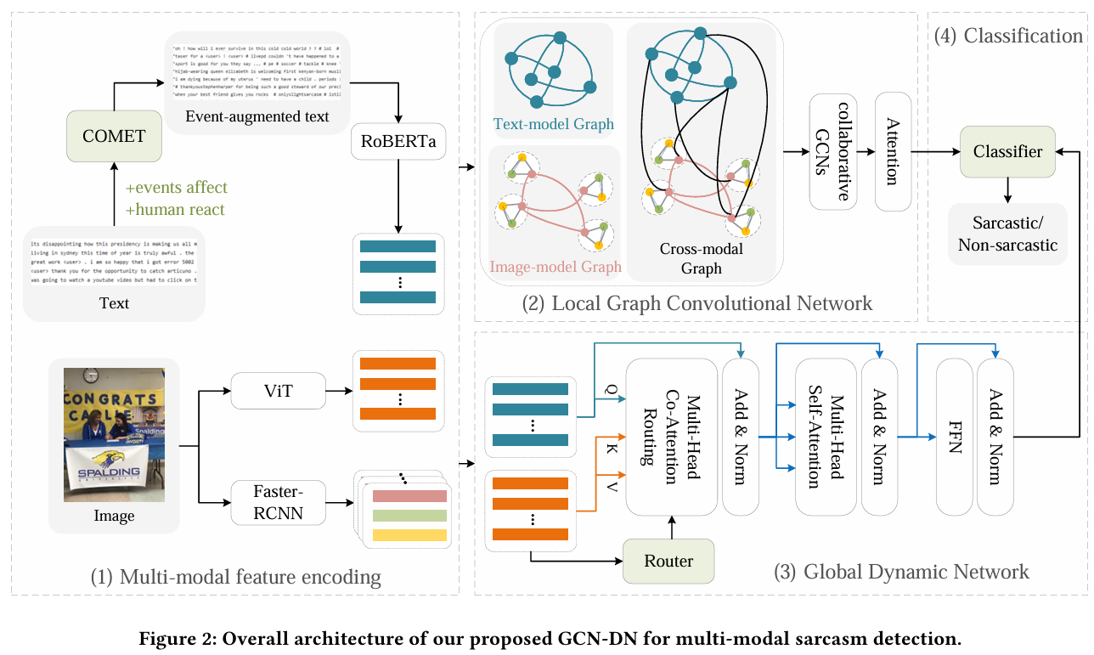
Method

Slide 4
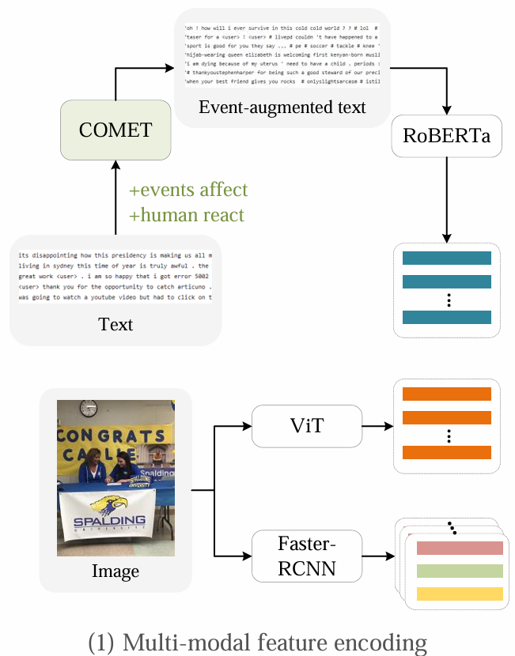
Method

Slide 5
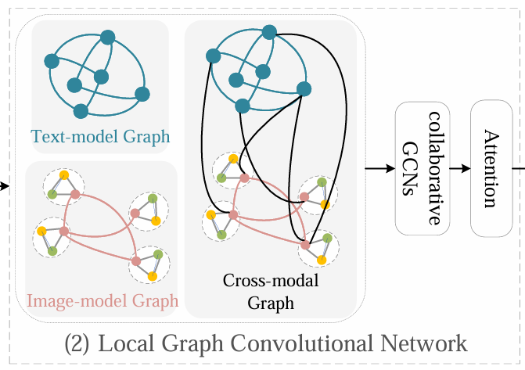
Method

Slide 6
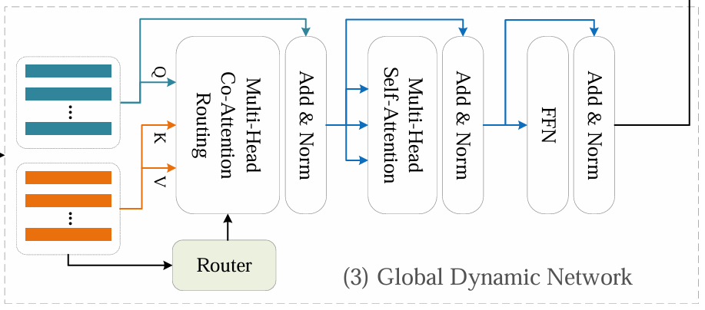
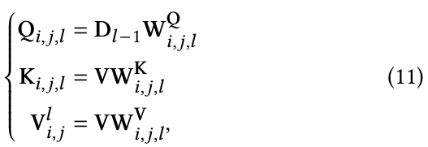
Method

Slide 7
Method

Slide 8
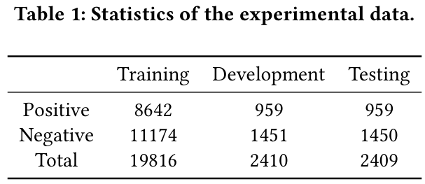
Experiments

Slide 9
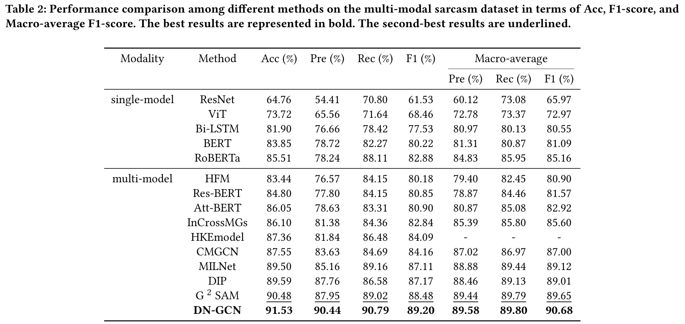
Experiments

Slide 10
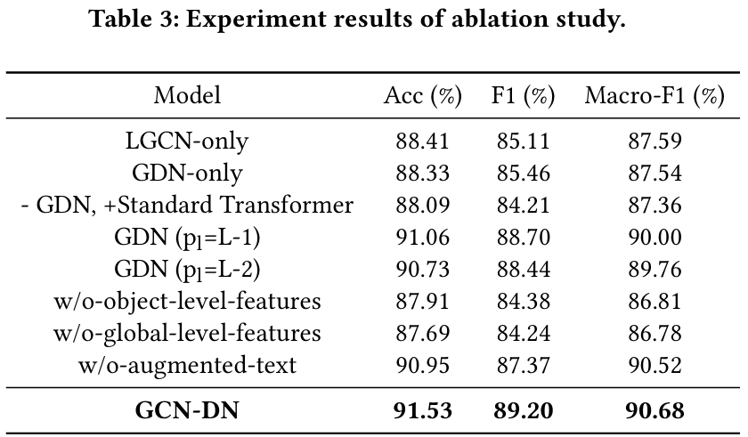
Experiments

Slide 11
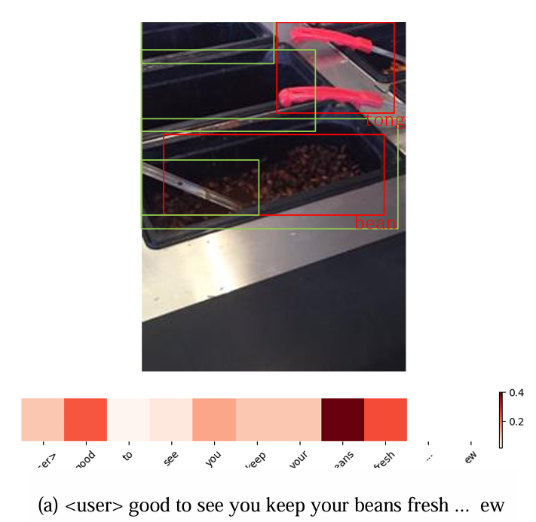
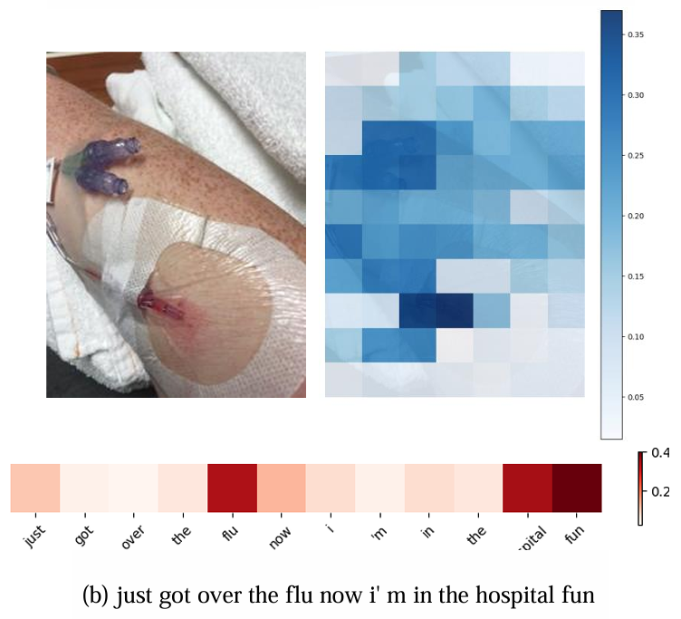
Experiments

Slide 12
Thanks!

